Slide 1
UE20CS461A – Project Phase – 2
END SEMESTER ASSESSMENT
Project Title : PAYCRYPTO – A Fintech Application for the Currency of the Future
Project ID : 127
Project Guide : Prof. Gauri Sameer Rapate
Project Team : 1) Aryansh Garg
2) Harsh Agrawal
3) Harshit Sharma
4) Sagarikha M.

Slide 2
Outline
Abstract
Summary of Requirements and Design ( Phase - 1)
Summary of Methodology / Approach (Phase - 1)
Design Description
Modules and Implementation Details
Project Demonstration and Walkthrough
Test Plan and Strategy
Results and Discussion
Lessons Learnt
Conclusion and Future Work
References

Slide 3
Abstract
Since we know that the buzz of cryptocurrency is growing exponentially and everyone is eager to try their hands on this new era currency, but the knowledge and awareness about it is quite low among the common people.
It takes a lot of time and efforts to get yourself educated in this domain which not many people are willing to spare and an additional challenge is how to find the reliable source of knowledge in this era of scams.
To overcome all these challenges and to provide people with one stop solution we are building PAYCRYPTO. It is an application from where people can start their crypto journey with minimum efforts.

Slide 4
Abstract
When it comes to transactions and investments, cryptocurrencies function much like conventional currency. Through the use of the stock market and transactions with both individuals and companies, it is possible to use this platform in a manner similar to that of managing fiat currencies such as dollars and rupees.
This platform's sophisticated price prediction feature—which is intended to predict the swings in value of well-known cryptocurrencies—is a strong argument for using it. By providing customers with early access to anticipated price movements, this service helps them reduce investment risk by allowing them to plan ahead and make the best possible investment decisions.
In addition to that, the users can do transactions to other users in cryptocurrencies as major companies like tesla and ford have already started accepting cryptocurrency as their mode of payment and in the coming future all the companies are going to do the same.

Slide 5
Summary of Requirements and Design
Functional Requirements:
Crypto Price Prediction: Prediction of the open and close prices of Ethereum
Wallet Creation: Wallet can be created by the users to make peer-to-peer transactions in cryptocurrency.
Real-time actual prices: The actual prices has to be displayed in real time so that the user can plan their moves accordingly.
Non-Functional Requirements:
Performance Requirement: The model performance should be optimal in regards to accuracy and timing
Security and privacy Requirements: The users’ accounts should be secured so that no illegal activities can be performed by others
Usability Requirements: The interface should be clean and minimal to provide the users better experience.

Slide 6
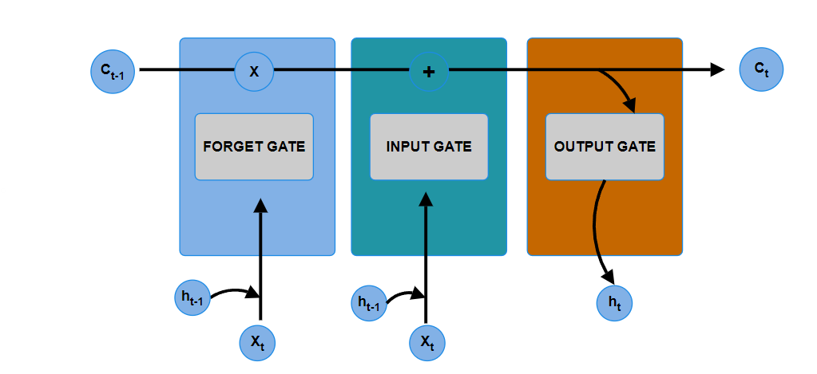
Summary of Methodology / Approach
ALGORITHMS :
LSTM : Long Short-Term Memory (LSTM) networks are a modified version of recurrent neural networks, which makes it easier to remember past data in memory. The vanishing gradient problem of RNN is resolved here. LSTM is well-suited to classify, process and predict time series given time lags of unknown duration. It trains the model by using back-propagation. In an LSTM network, three gates are present:

Slide 7
Summary of Methodology / Approach
ALGORITHMS :
For sentiment- analysis, TextBlob algorithm has been implemented. To implement that, first the news headlines have been extracted that are related to “Ethereum” and data pre-processing has been done to remove the symbols, special characters and stop words.
The output of the sentiment analysis is a score between -1 to 1 where the lesser the score the negative the sentiment and vice versa.

Slide 8
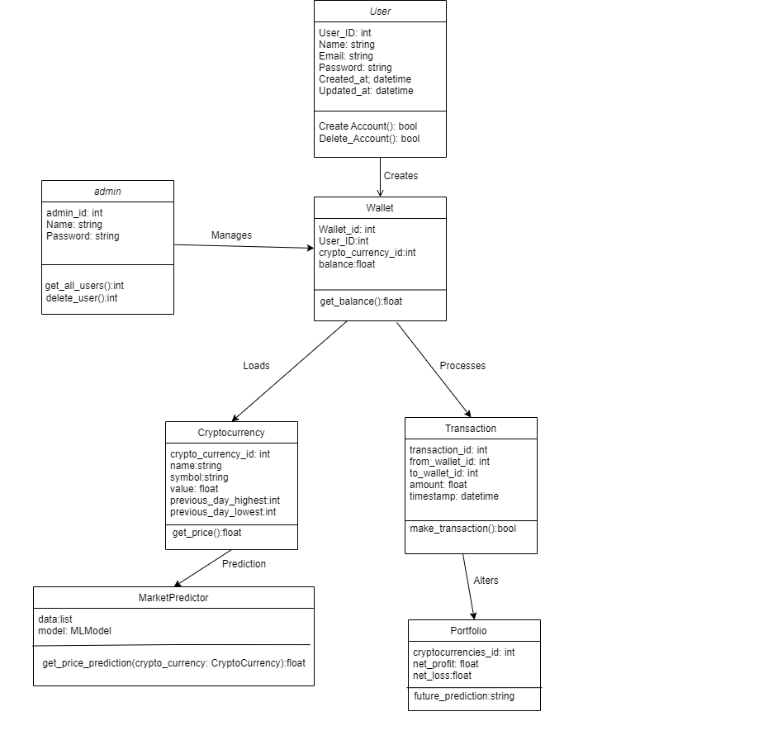
Design Description
Master Class
Diagram:

Slide 9
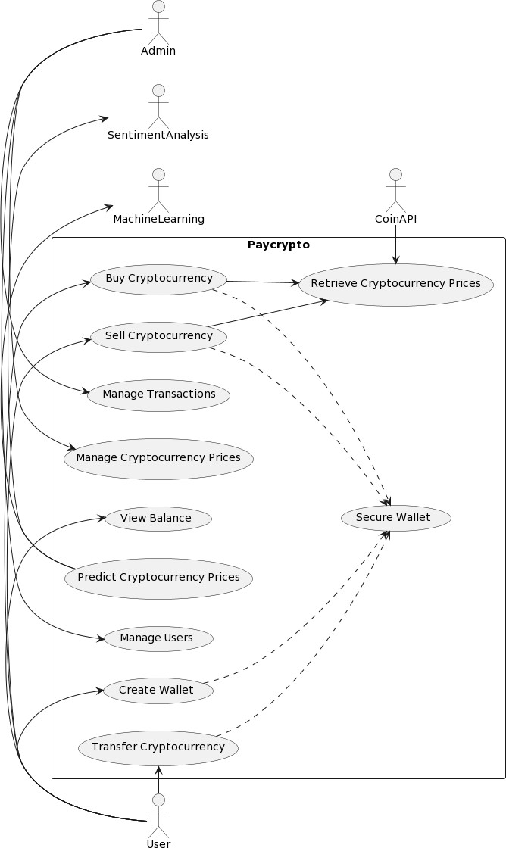
Design Description
Use Case Diagram:

Slide 10
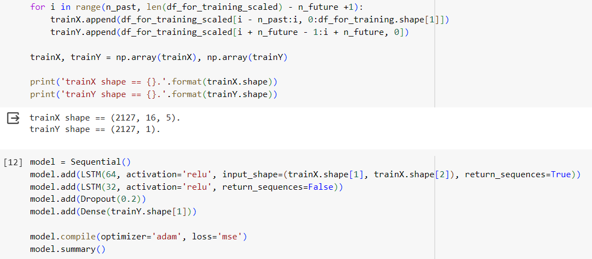
Modules and Implementation Details
Price- prediction:
For price prediction, multivariate LSTM model has been implemented. The model uses five features for the forecasting. Since it is a multivariate model, only one day prediction is possible.
Two LSTM layers, one dropout layer and one dense layer has been implemented

Slide 11
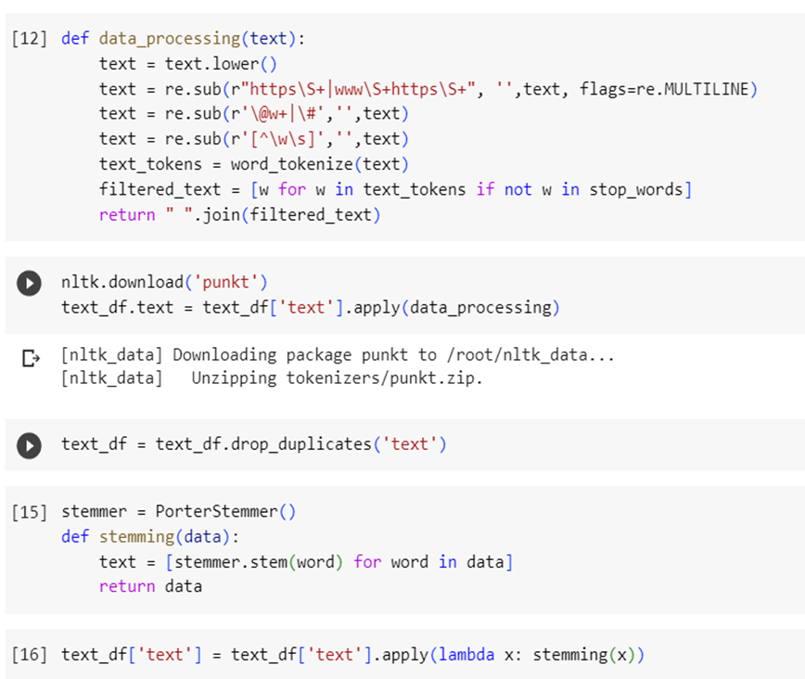
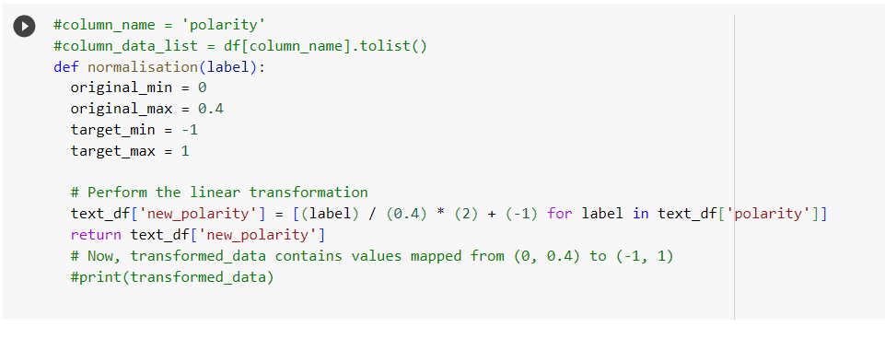
Modules and Implementation Details
Sentiment analysis:
For sentiment analysis of news data, Textblob is used to get the
sentiment of the news headlines.
The sentiment score is then further normalized to give the value between -1 and 1 where the lesser the value, the negative the sentiment.

Slide 12
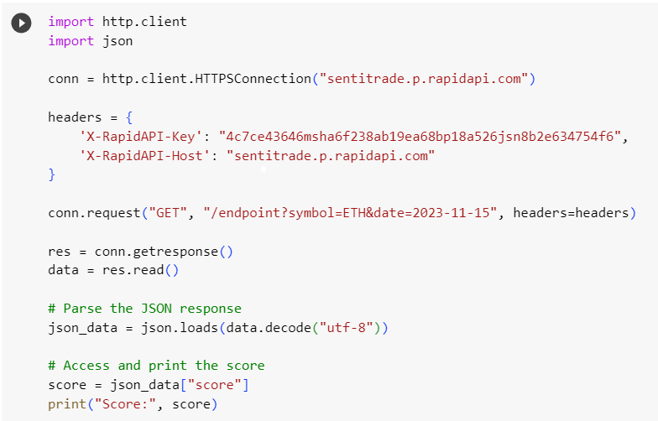
Modules and Implementation Details
Sentiment analysis:
For getting the news data of everyday, SentiTrade API has been
implemented which scrapes the news headlines related
to the cryptocurrency market.

Slide 13
Project Demonstration
Demonstration will be done.

Slide 14
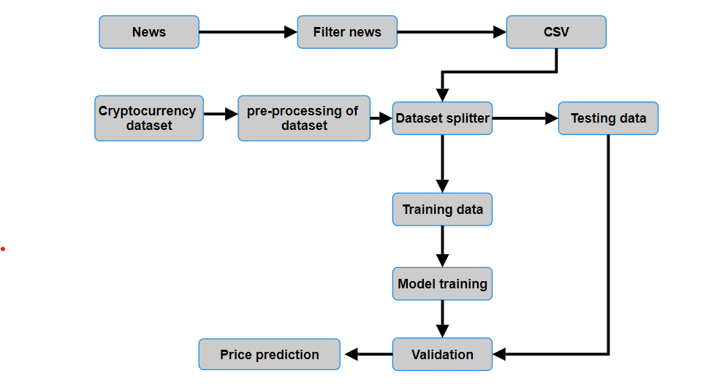
Walkthrough

Slide 15
Test Plan and Strategy
For testing the different modules of the project, unit testing method has been followed since all the different modules provide different functionality and each one has to be working independently.
For the frontend part, as it has been build in react JS component testing is followed.
API testing has been performed using postman.
Finally, integration testing has been done to test the feasibility and working of all the modules together

Slide 16
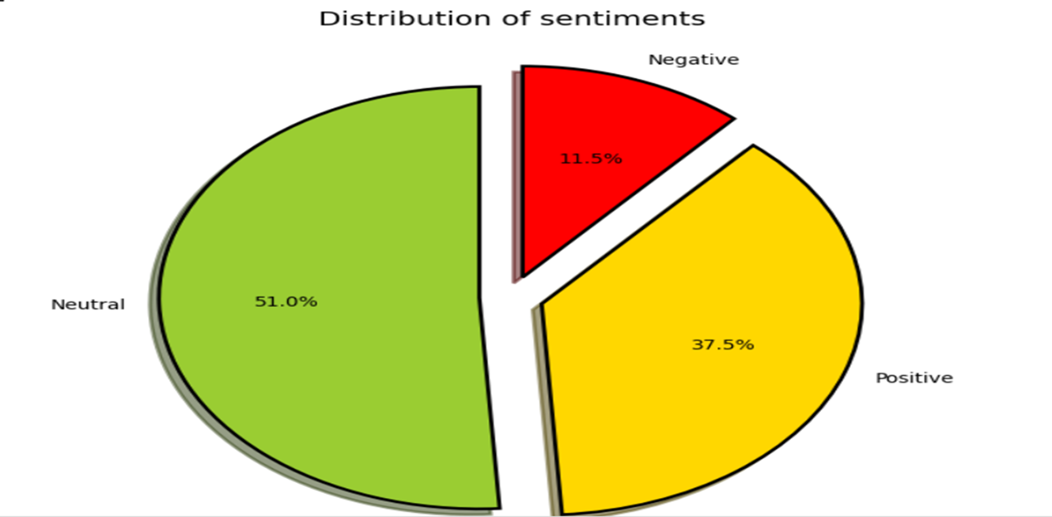
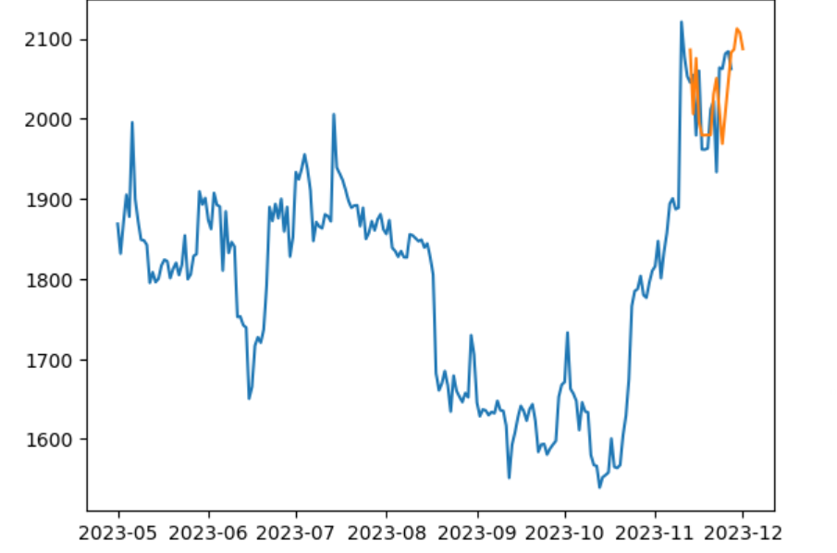
Results and Discussion
For sentiment analysis of news data, after the dataset preprocessing the following results have been obtained for sentiment distribution.
The blue graph shows the actual prices and the orange graph shows the predicted prices which are satisfactorily close to the actual prices.

Slide 17
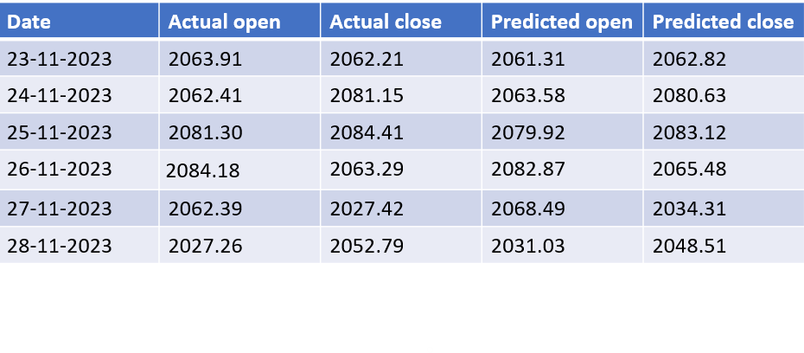
Suggestions from last review
Below diagram shows the actual prices and the predicted prices for last 6 days
The number of news headlines used for the sentiment analysis has been set to 50.

Slide 18
Schedule
The project was estimated to be complete in December,2023
The team has met the deadlines to produce the full implementation of the project.

Slide 19
Lessons Learnt
Initially we started with twitter for sentiment analysis but as the project proceeded news headlines have been used for the same.
For time series forecasting, LSTM provides better accuracy than other models compared initially.

Slide 20
Conclusion and Future work
TextBlob for news sentiment analysis provides satisfactory results by giving the sentiment score between -1 and 1 where lesser score means negative sentiment and higher score means positive sentiments and near zero infers neutral sentiments.
For the price forecasting, LSTM model provides satisfactory results which has been implemented with 2 LSTM layers, one dense layer and one dropout layer.
In the future, licenceing and permissions can be obtained to provide wallet to the users for the transactions and buying currencies.

Slide 21
References
Multivariate cryptocurrency prediction: comparative analysis of three recurrent neural networks approaches : Seng Hansun1* , Arya Wicaksana1 and Abdul Q. M. Khaliq2
DL-GuesS: Deep Learning and Sentiment Analysis-Based Cryptocurrency Price Prediction: RAJ PAREKH, NISARG P. PATEL, NIHAR THAKKAR, RAJESH GUPTA
Cryptocurrency Price Prediction Using LSTM and GRU Networks: Andrei-Alexandru Encean,Daniel Zinca
Forecasting Bitcoin price direction with random forests: Syed Abdul Basher , Perry Sadorsky

Slide 22
Thank You

